Slide 1
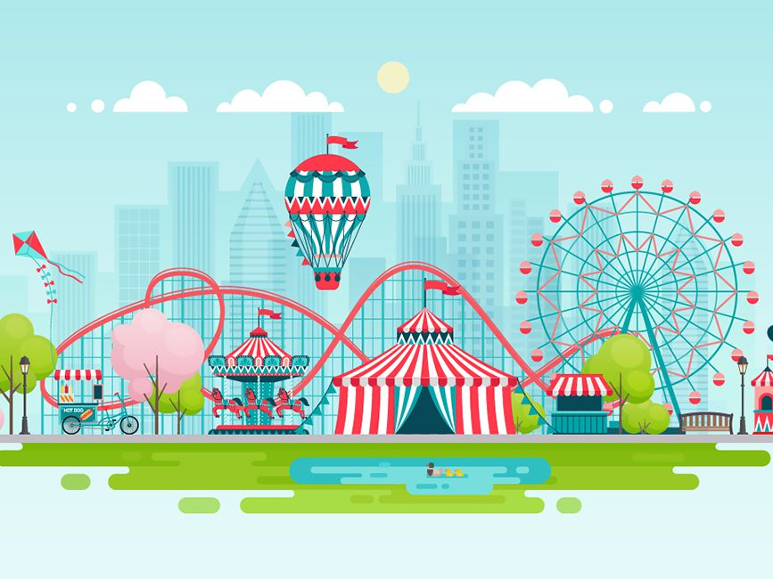
Our Rube Goldberg Machine
A Day at the Amusement Park
Alexander Williamson, Trevor Lau, Celine Semaan, & Jenna Rutberg
Notes:
Amusement Park Picture
AJ

Slide 2
For our Rube Goldberg Machine,
we created an Amusement Park Theme.
The design begins at the hill & loop, and ends with the final task of the Merry-Go-Round spinning.
Notes:
AJ

Slide 3
The Problem
To design and successfully build a Rube Goldberg Machine. The machine must consist of six machines and result in a minimum of five energy transfers. When the machine has completed all steps, an overall final task must be met. The user of the machine must benefit from the final task that is met.
Notes:
Jenna

Slide 4
Goals
We wanted to create a design with the following components:
Minimum of eight steps
Six simple machines
Five energy transfers
End task met
Creative
Complex
Notes:
Jenna

Slide 5
Constraints
Space to create and store project
Portability
Opportunity to work together in-person
Number of members on-campus
Access to on-campus resources
Access to materials
Time to complete project
Notes:
Trevor

Slide 6
Final Design Update
We made several changes to our design:
The catapult is no longer included.
Pulley switched to an elevator-like machine.
Buttons for drawbridge, elevator, and robot car exchanged to distance sensors.
Ferris wheel is gravity-operated instead of powered by a motor.
More ramps included than planned.
Wedge and box switched to a seesaw.
Notes:
Trevor

Slide 7
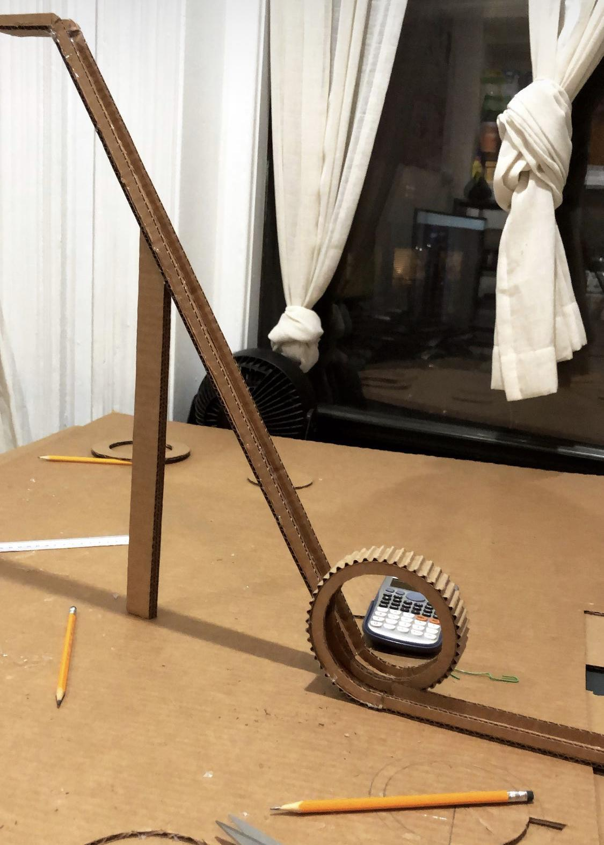
Loop
How it works...
The marble sits at the top of the hill.
When the marble is pushed from behind, it rolls onto track, into the loop, and comes back out with a significant amount of speed.
Notes:
Celine

Slide 8
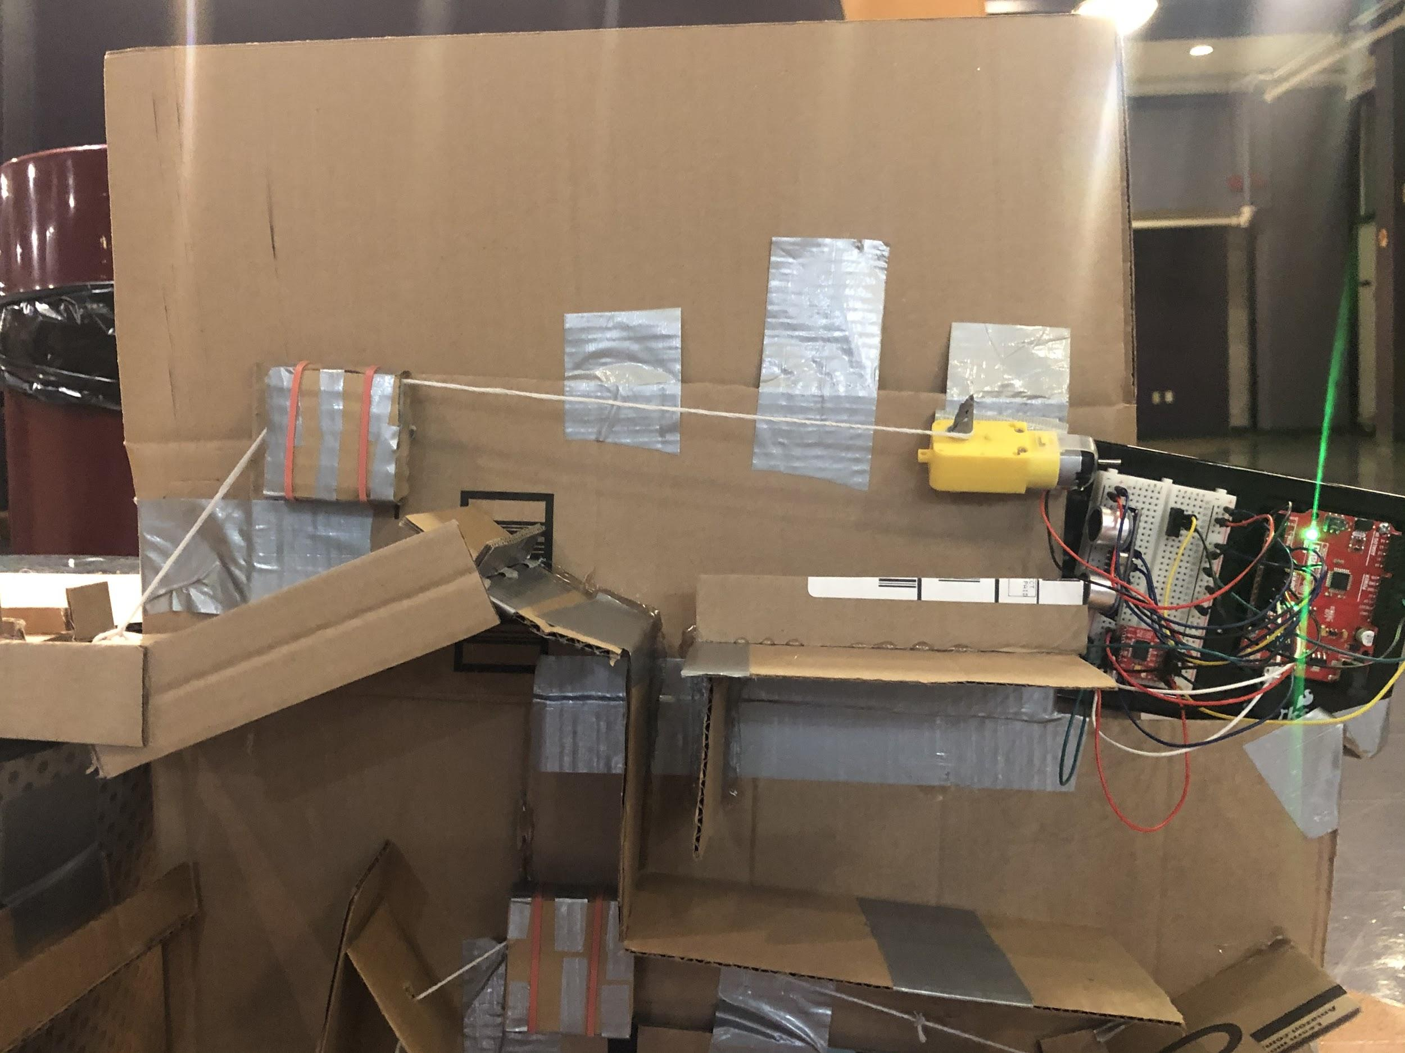
Drawbridge
How it works…
The marble enters from the loop with enough velocity to make it up a short ramp.
The marble collides with a container holding a second marble, setting off a chain reaction of events that eventually leads to the pulley lowering the drawbridge.
Notes:
Trevor

Slide 9
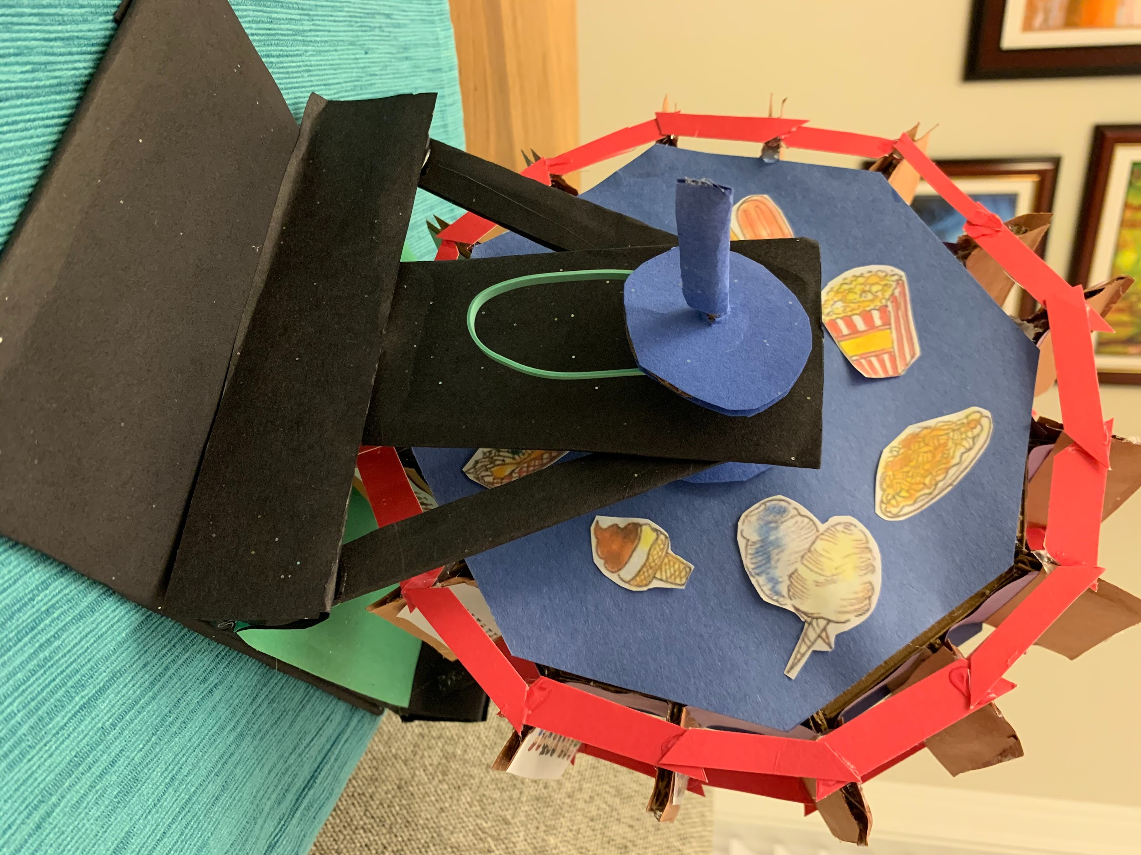
Ferris Wheel
How it works...
The ferris wheel begins at rest.
Added weight from the marble results in the ferris wheel rotating due to the downwards gravitational force.
Notes:
Jenna

Slide 10
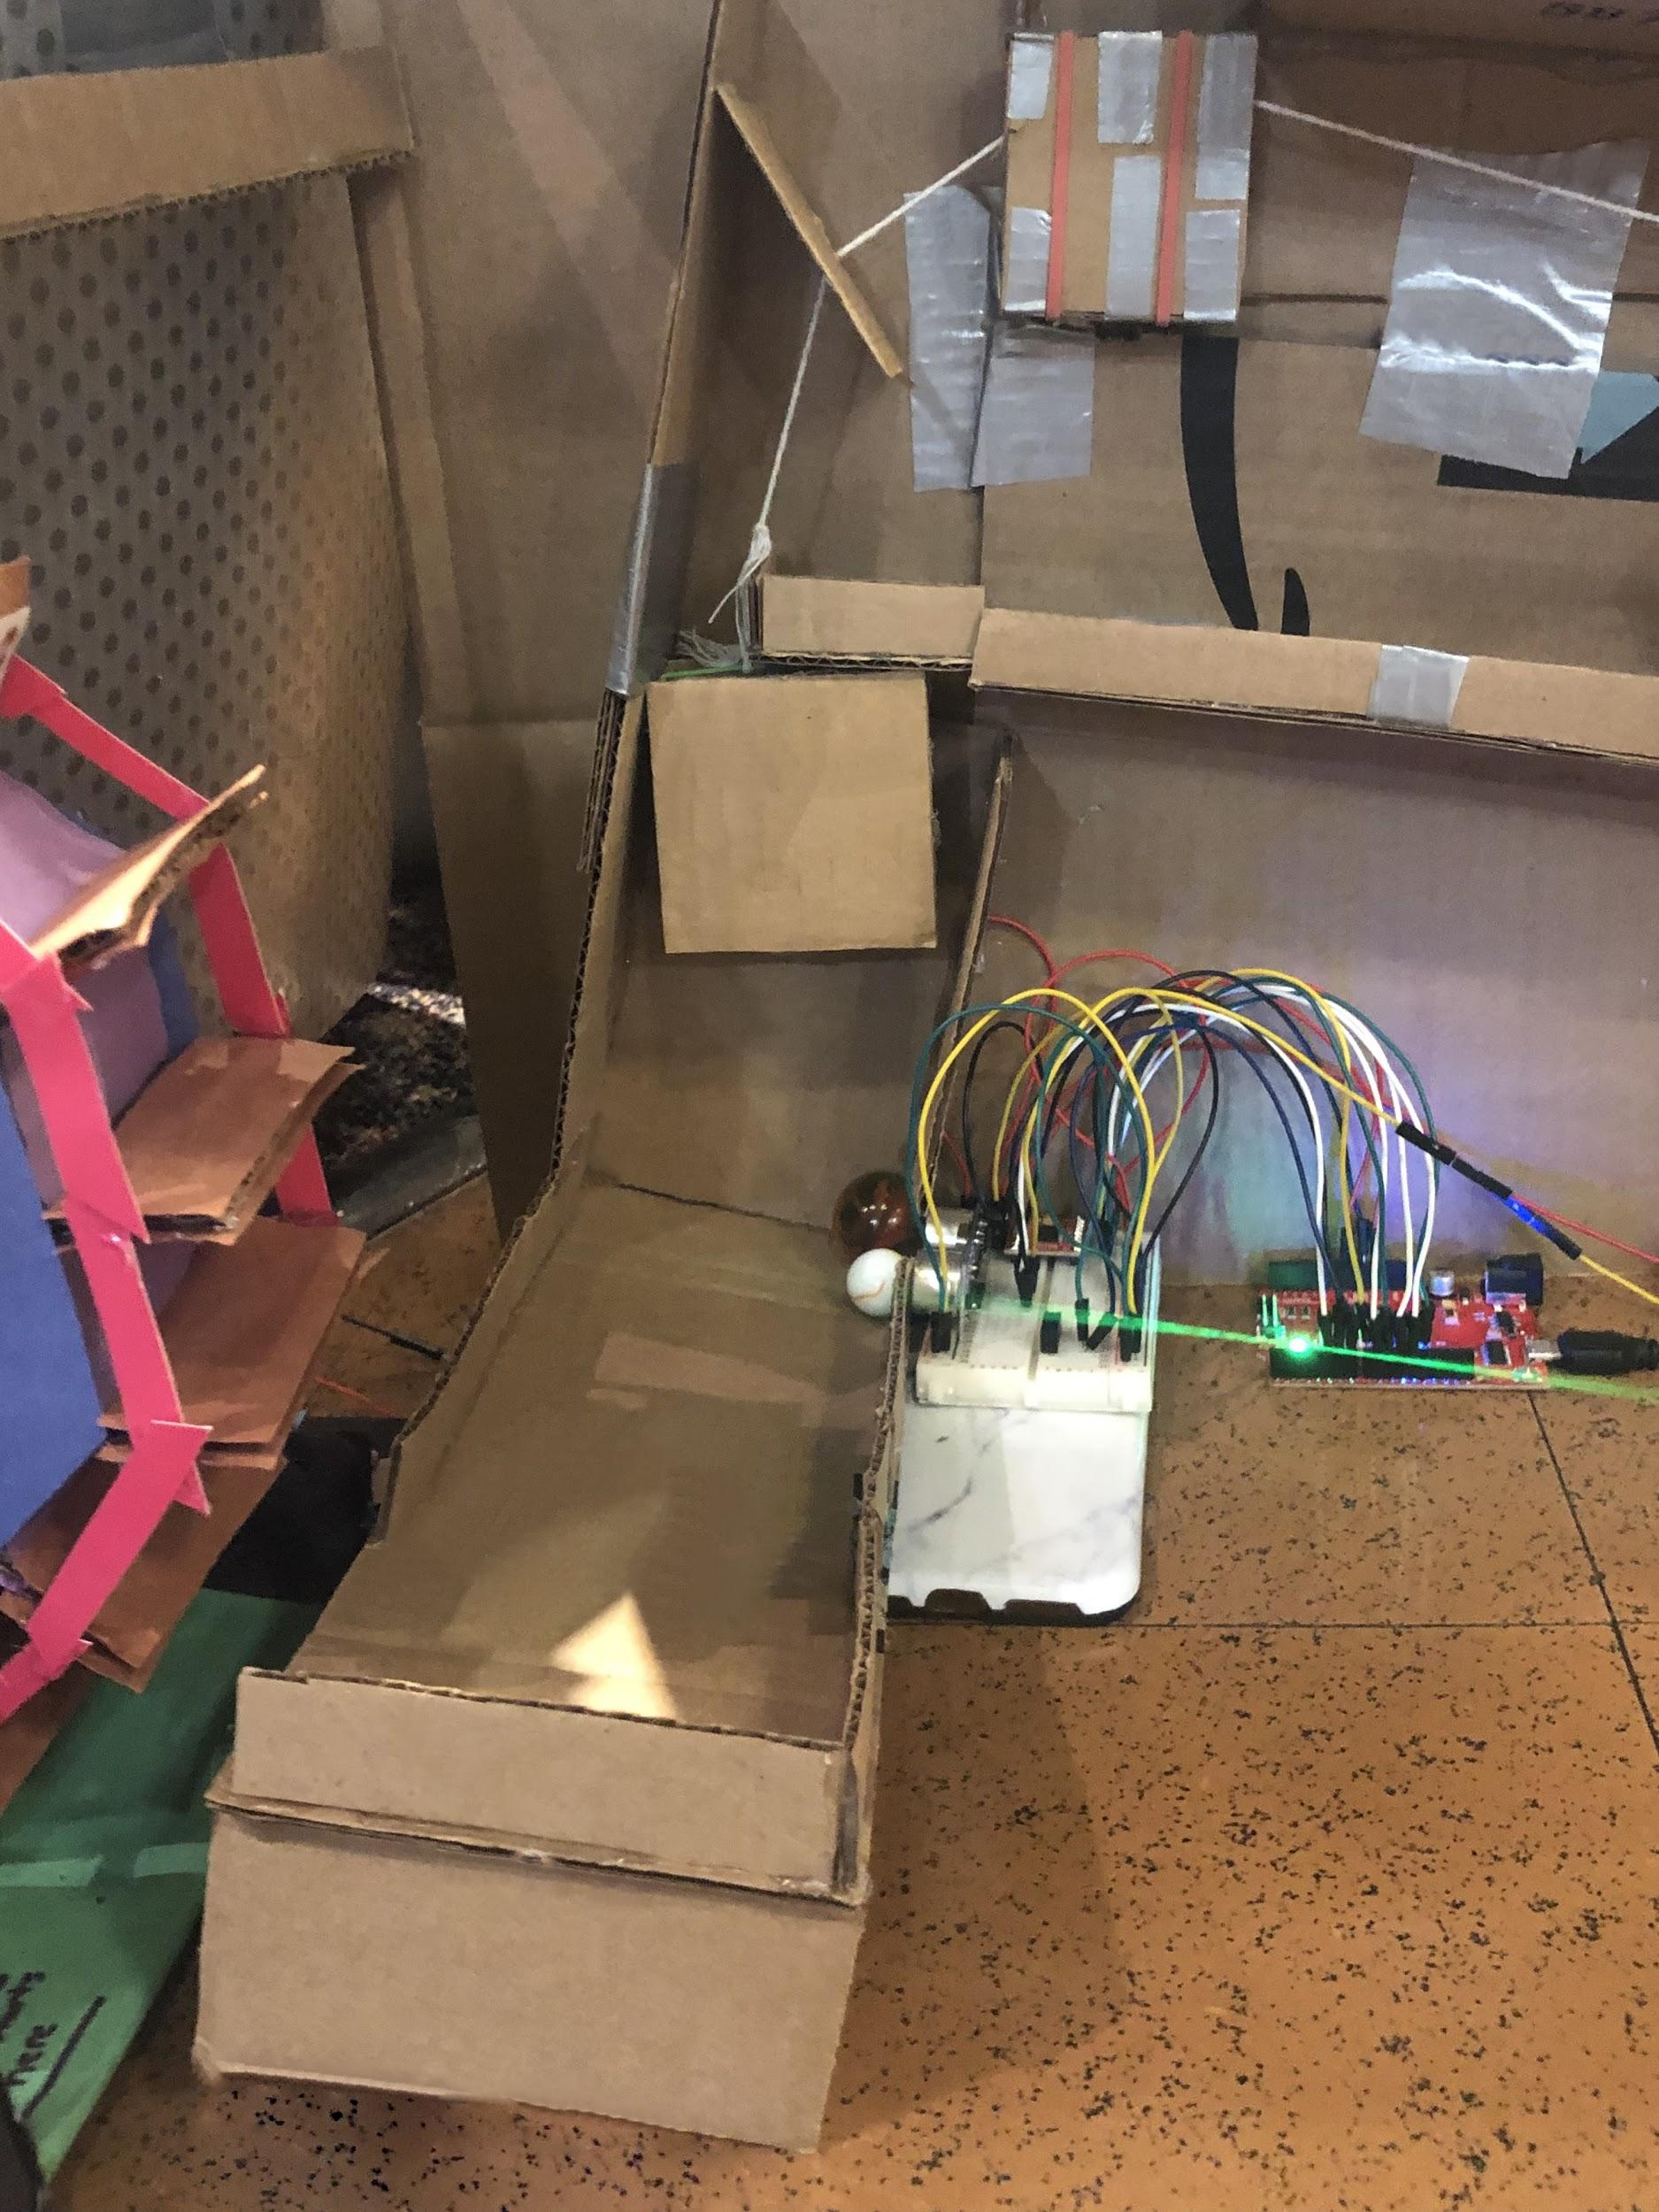
Elevator
How it works…
The marble is dropped off by the Ferris wheel, triggering a distance sensor.
The activation of the distance sensor causes a pulley to raise a cardboard box, which sends a different marble rolling towards the end of the contraption.
Notes:
Trevor

Slide 11
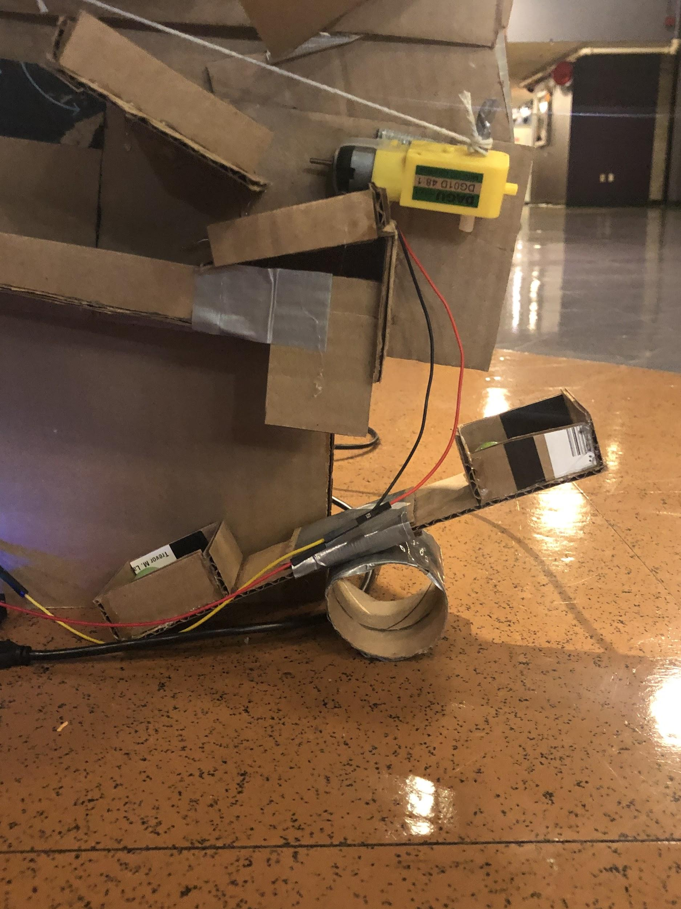
Seesaw
(replaced box/wedge)
How it works…
Throughout the machine, marbles are led to be dropped into the raised basket of the seesaw.
The eventual collective weight of the marbles is enough to offset that of the raised basket, shifting the balance of the seesaw.
Notes:
AJ

Slide 12
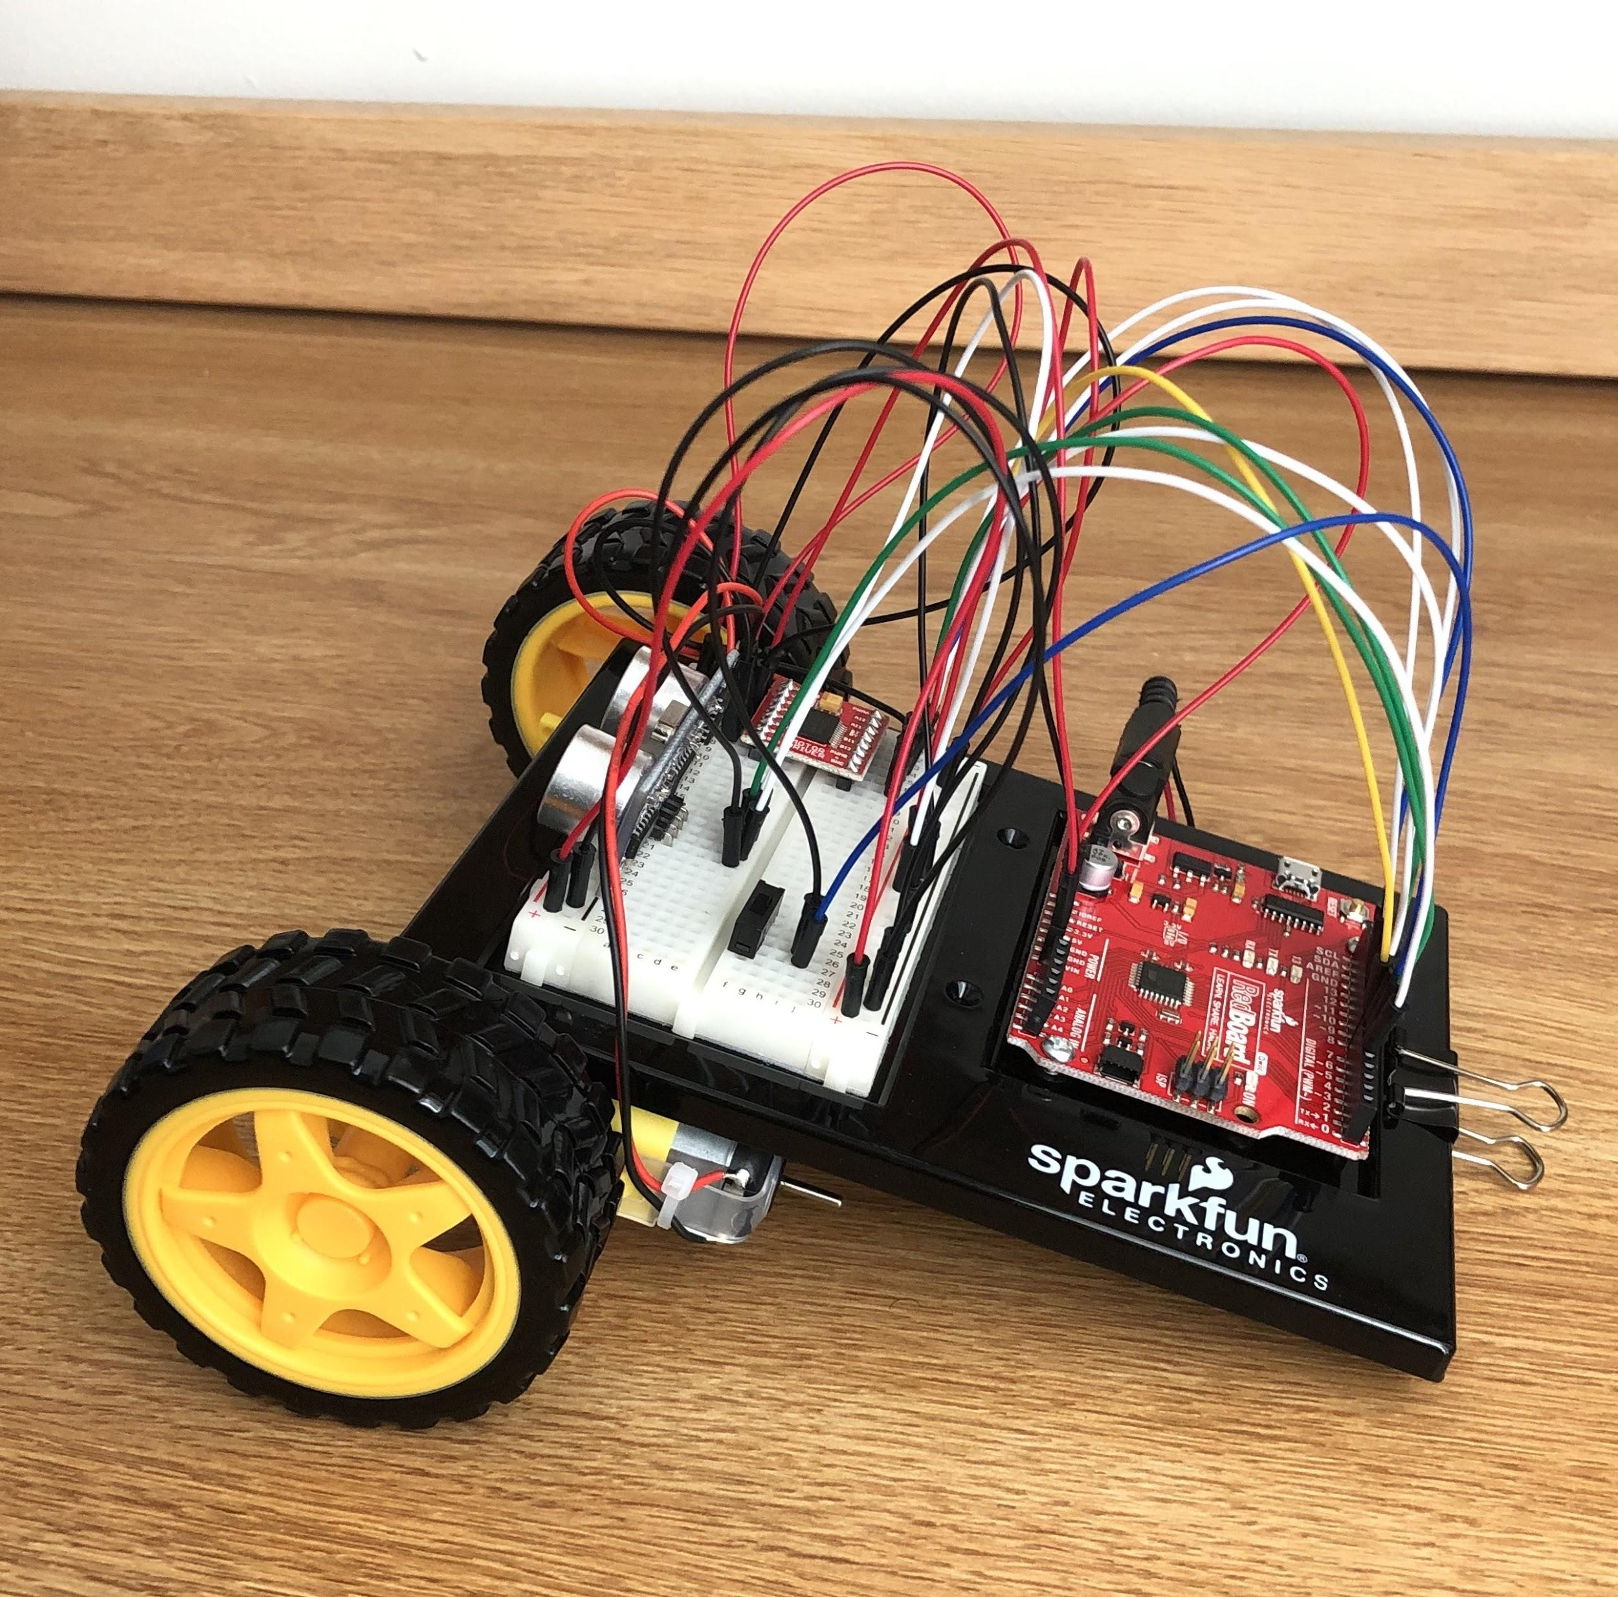
Autonomous Robot Car
How does it work?
A program is uploaded from computer using Arduino Software to circuit board which sits on top of the car.
Robot car is powered by batteries that are located under it.
It is programmed to go forward then ride in a circle around another machine: the merry-go-round.
Notes:
Celine

Slide 13
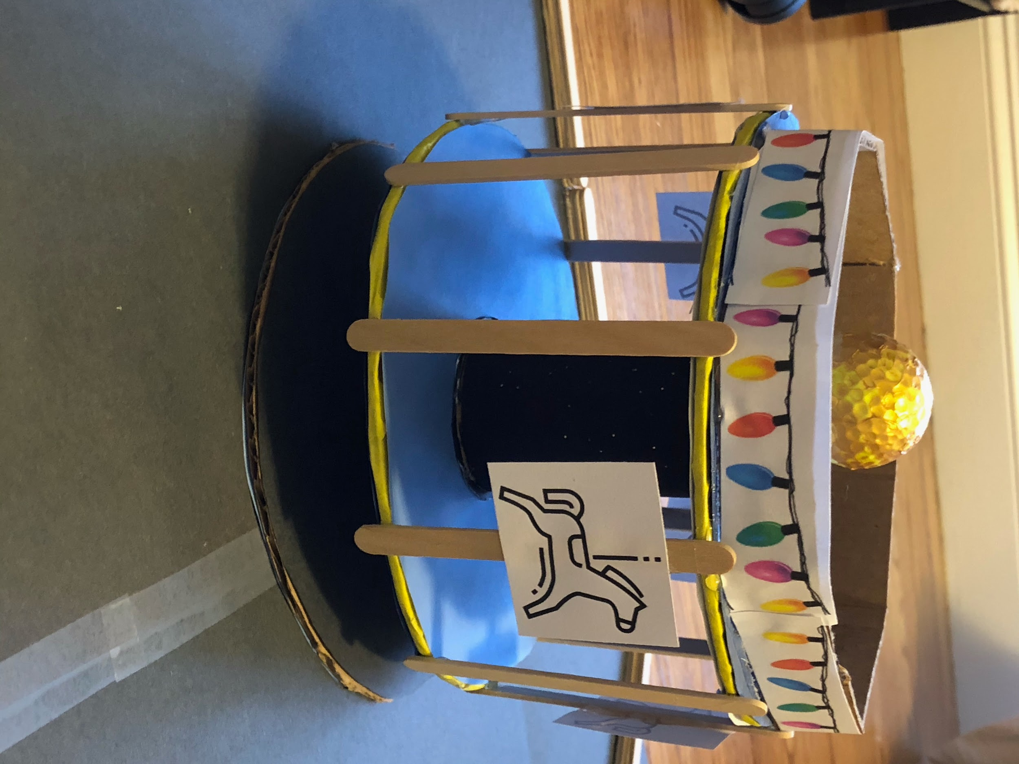
Merry-Go-Round
How does it work?
Axle is secured on bottom with base, and on top with golf ball.
Robot car is programmed to circle merry-go-round.
String on moving robot car attached to merry-go-round results in rotation.
Notes:
jenna

Slide 14
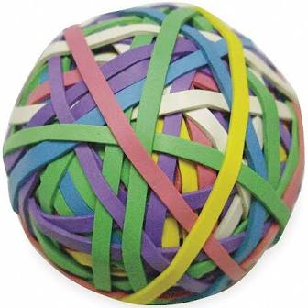
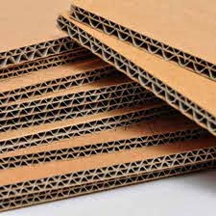
Cost Analysis
We spent a total of $50 with purchases including:
Door Hinge for Drawbridge
Rubber Bands for Catapult & Ferris Wheel
Ruler for Catapult
Cardboard
Glue Gun & Glue Sticks
AA Batteries
Marbles
Notes:
Rubber Band Picture
Cardboard Picture
AJ

Slide 15
Our Final Design
5 types of simple machines
Incline Plane (~7)
Lever (2)
Wheel & Axle (3)
Pulley (2)
At least 8 energy transfers
Potential energy to kinetic energy (5)
Potential energy to kinetic energy to electrical energy to mechanical energy (1)
Potential energy to mechanical energy to kinetic energy (1)
Potential energy to electrical energy to kinetic energy (1)
At least 9 steps
Notes:
AJ

Slide 16
Here is our final design!
Notes:
Insert Video
Celine

Slide 17
Steps of our Design: Part 1
A marble sits on top of a hill. It is pushed and begins rolling down the hill, completes the loop, and reaches the drawbridge. The marble hits and knocks over a container with a second marble.
The second marble hits a bigger marble that starts rolling and triggers a motion sensor. The previous marble bounces off the latter and drops into a track that leads to the seesaw. Weight is added to the seesaw. The motion sensor triggers a program that starts the motor for the drawbridge. The drawbridge opens, and the original marble falls through.
The original marble reaches the ferris wheel and rides it until it slides off at ground level.
At ground level, the marble rolls towards the elevator, down a track and triggers the distance sensor which starts the motor of the elevator.
Notes:
Celine

Slide 18
Steps of our Design: Part 2
The elevator begins moving and gets raised until it encounters a section of the track on which a marble is placed. The track tips, and the marble rolls out onto the other section of track which leads to the seesaw.
The added weight of the second marble causes the seesaw to fall down and tilt.
The distance sensor is triggered by the movement of the seesaw, and a signal is sent to the autonomous robot car. The autonomous robot car is programmed to circle the merry-go-round.
The robot car, with a string attached to it on one end and to the merry-go-round on the other begins its circular trajectory around the other machine, causing it to spin. The end task is achieved.
Notes:
Trevor

Slide 19
Energy Transfers
Potential to Kinetic Energy
Hill & Loop: Marble at rest on hill then set into motion.
Ferris Wheel: Wheel is at rest then begins rotating due to weight of added marble.
Seesaw: At rest, then lowers due to added weight from marble.
Merry-Go-Round: Merry-Go-Round is at rest and begins to spin due to Robot Car.
Potential to Kinetic to Electrical to Mechanical Energy
Drawbridge: Marble at rest begins moving due to collision which triggers distance sensor which sends signal to start drawbridge motor.
Potential to Mechanical to Kinetic Energy
Drawbridge: Drawbridge is at rest then opens once motor starts.
Elevator: Elevator is at rest then begins moving due to motor turned on.
Potential to Electrical to Kinetic Energy
Robot Car: Car is at rest, and then begins moving due to signal sent from activated distance sensor.
Notes:
Jenna

Slide 20
Overall Scientific Concepts
Conservation of Energy & Momentum was seen throughout our entire design.
We also saw:
Torque required to lower seesaw
Unstable equilibrium of ferris wheel
Centripetal acceleration with the ferris wheel & merry-go-round
Notes:
AJ

Slide 21
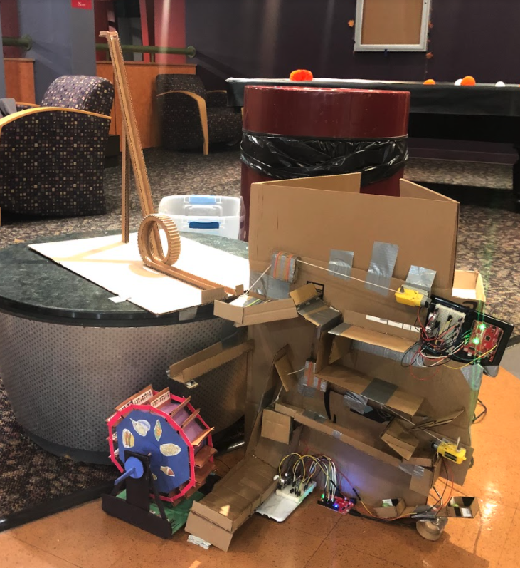
What went well?
Each machine worked well individually.
Initially, building the assembly went smoothly.
We were able to successfully integrate new features of assembly into final design.
Structurally sound construction.
Notes:
Celine

Slide 22
What can be improved?
Develop more consistent release method for marble at beginning.
The set-up for the drawbridge simpler and easier to replicate.
Using 3D printed pulley pieces and pulley machine instead of elevator.
Ferris wheel powered by motor, and walls higher.
More reliable mechanism for attaching robot car to merry-go-round such as a track for string.
More reliable motors.
Complete in one trial.
Build together.
Notes:
Trevor

Slide 23
What we learned?
How to improvise
Work with material we had
How to complete a project while in different places
More trials throughout the building process would have allowed us to better adjust the scope of our project.
Notes:
Celine

Slide 24
Conclusion
In the end, we were able to have most of the assembly work together in one trial. The inconsistency in the motors running created problems in the overall assembly.
In the future, we hope to make changes and incorporate more reliable motors to complete the machine in one trial.
Notes:
Celine

